Slide 1


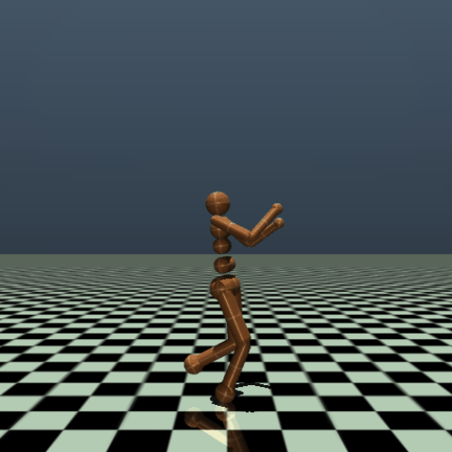
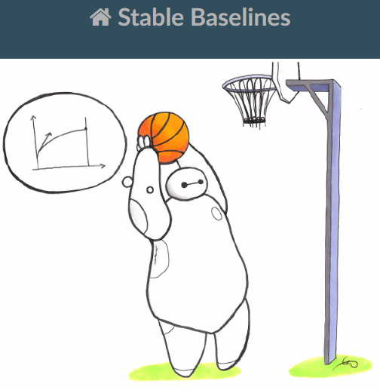
Customizing OpenAi Gym Environment With Sable Baselines Reinforcement Learning Agents
Grupo W
André Sousa 202108571
David Scarin 202108314
Paulo Silva 202107359

Slide 2
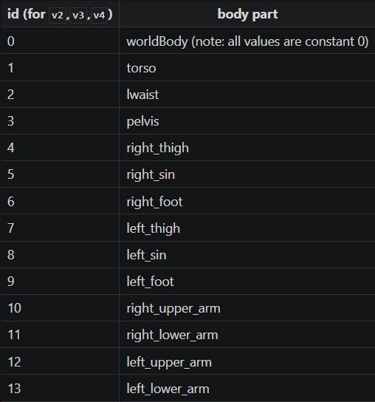
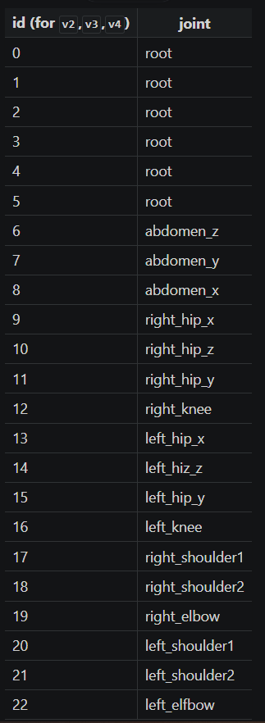
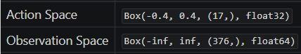
Environment Description

Slide 3
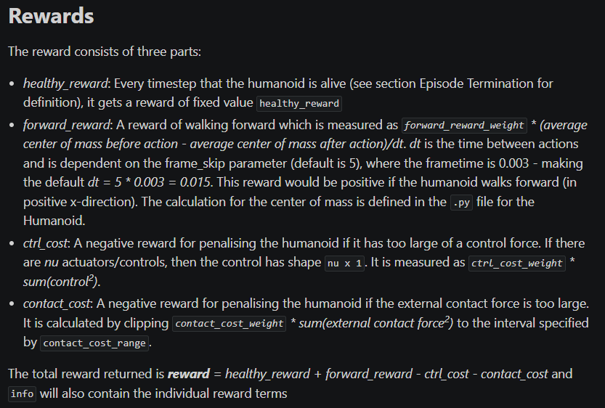
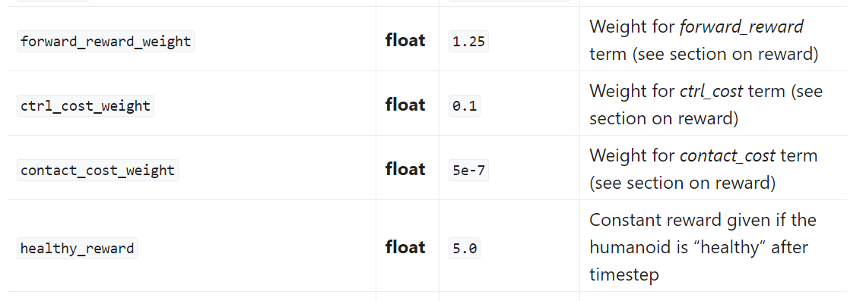
Environment Description

Slide 4
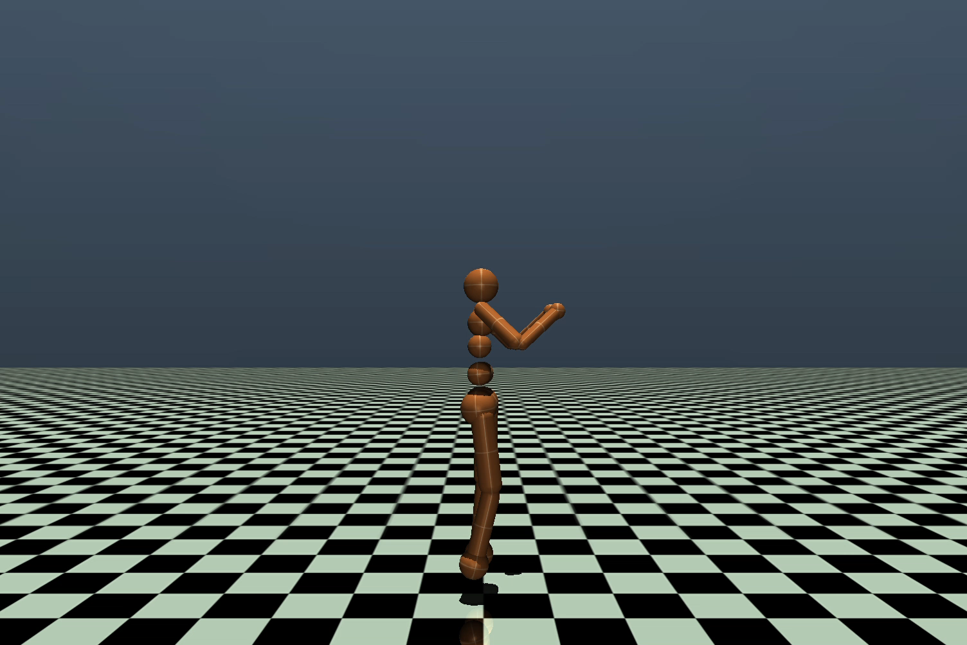
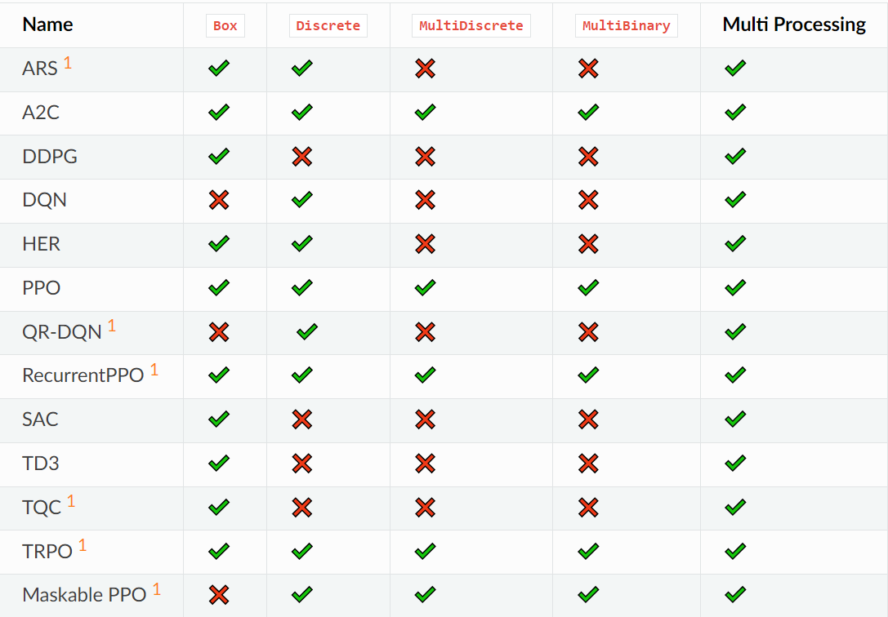
Developed Work

Slide 5
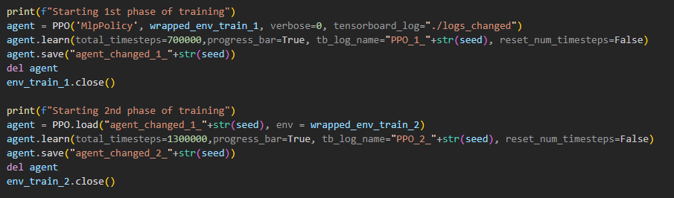
Developed Work
Separate training into 2 phases
Split of 65/35 between first and second phases

Slide 6
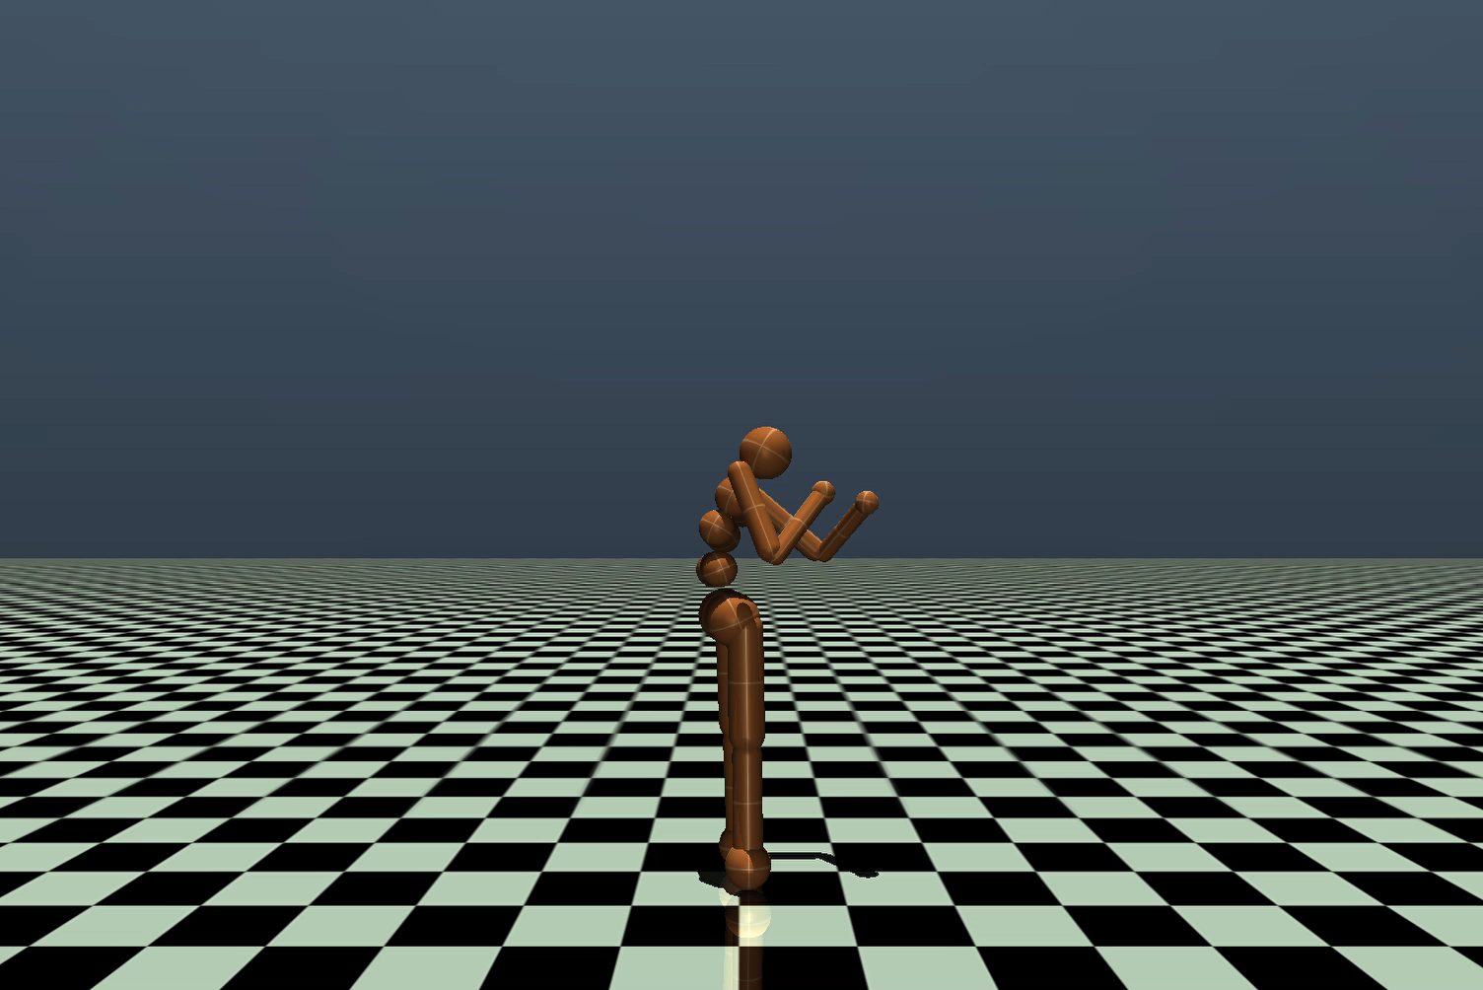
Developed Work
Testing environment
2 training phases with different weights

Slide 7
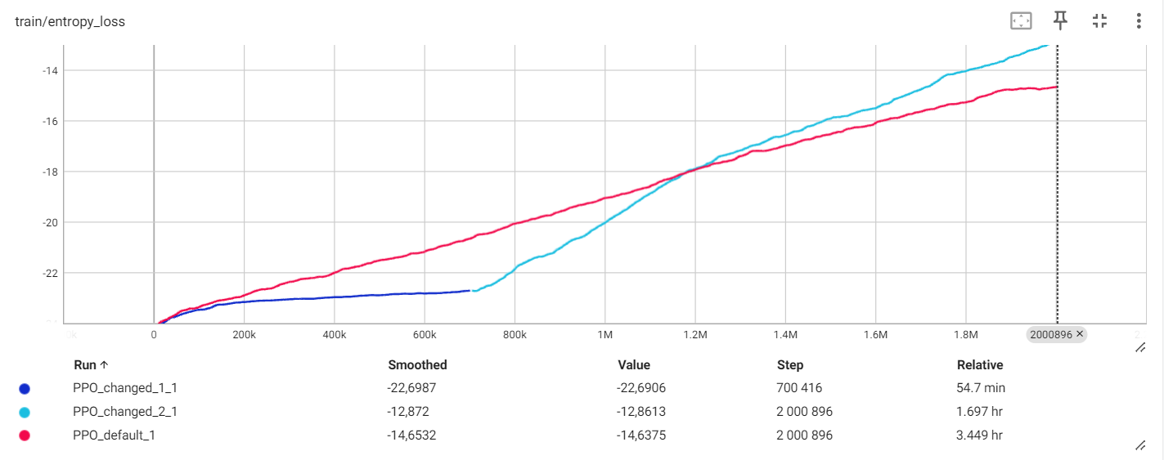
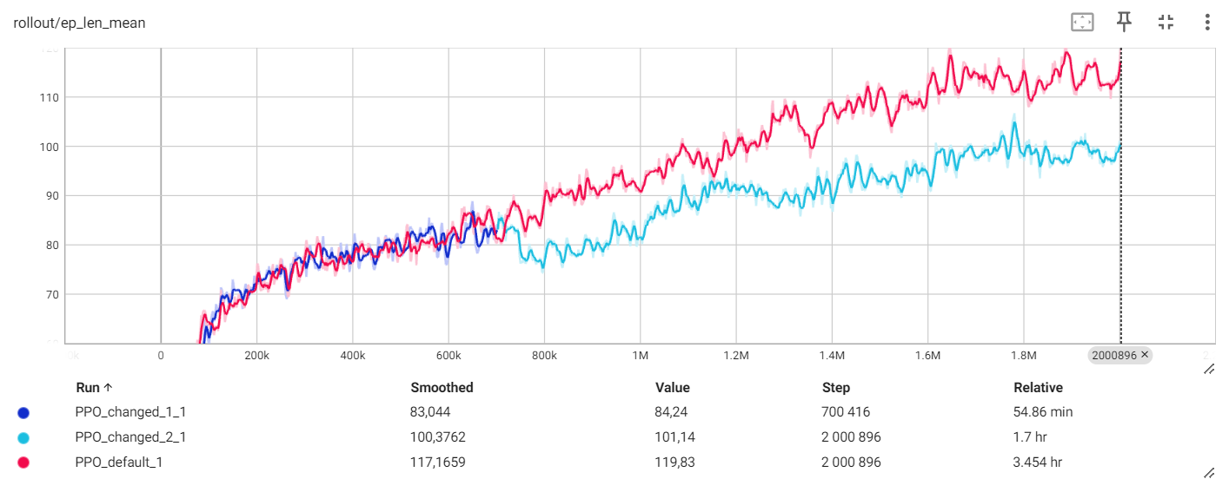
Experimental Part

Slide 8
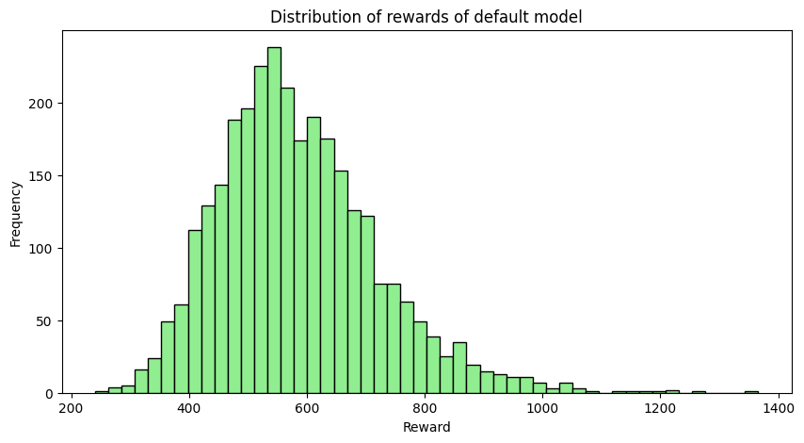
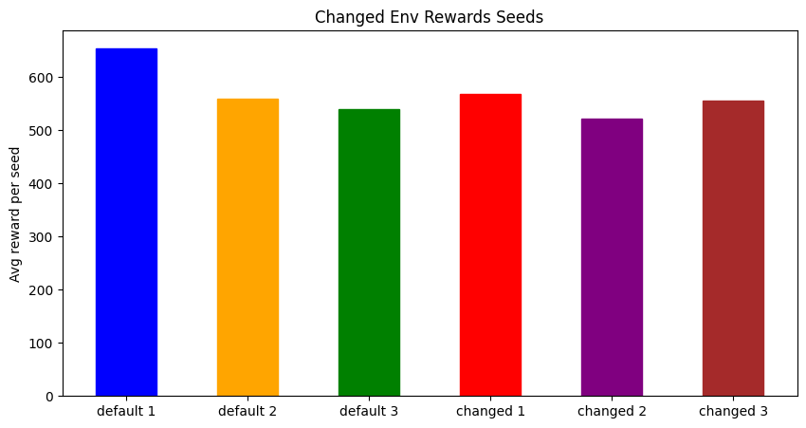
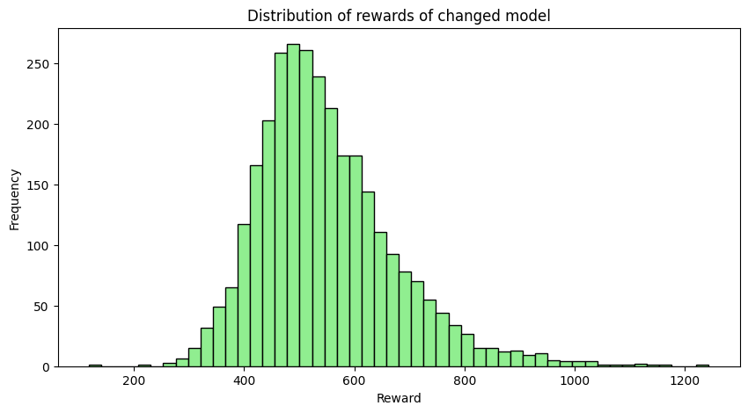
Analysis of Results

Slide 9
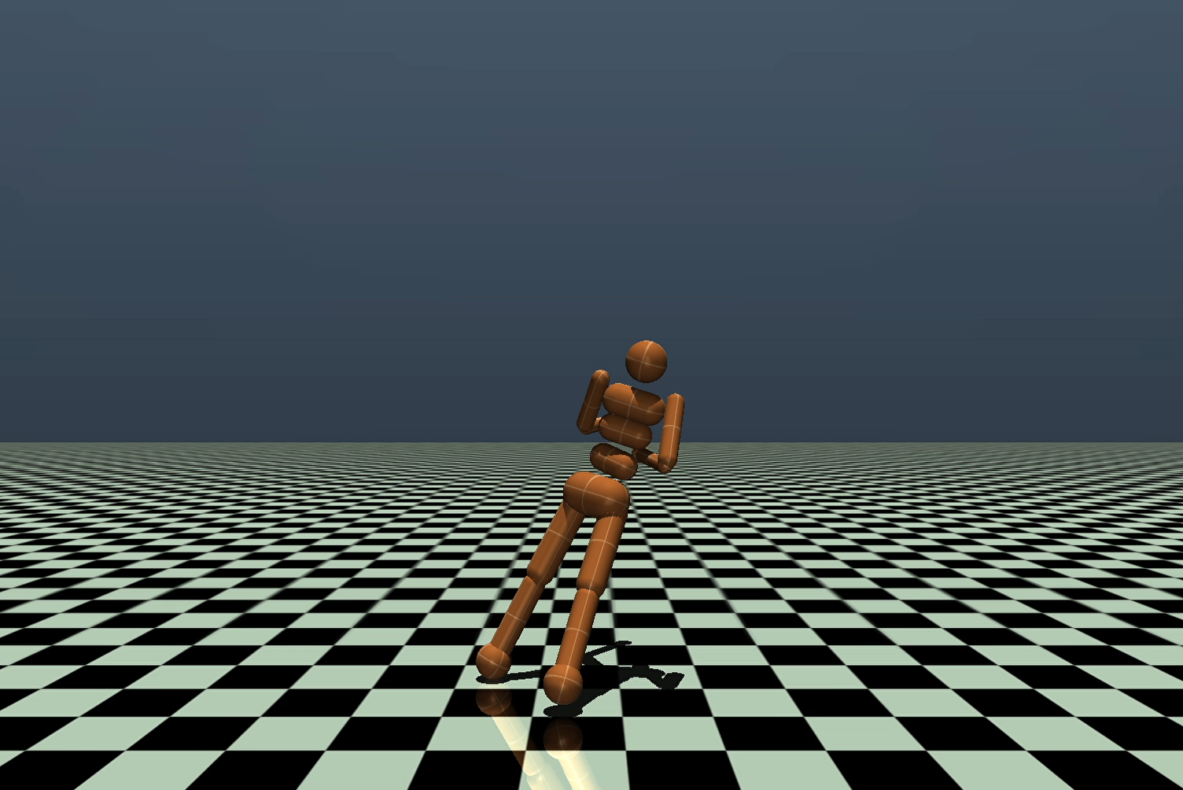
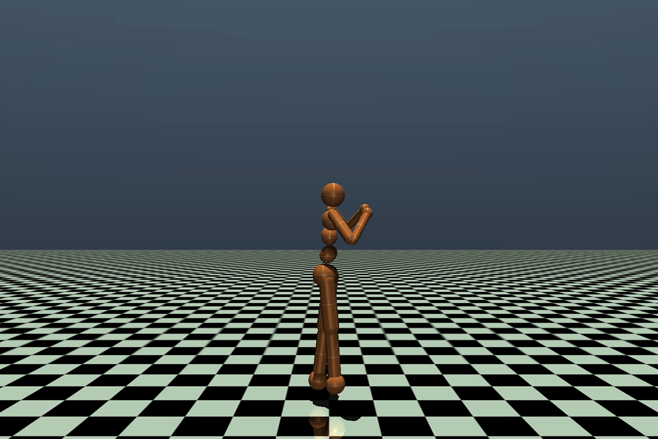
Comparing Results
Base Implementation
Experimental Implementation

Slide 10
Conclusions and Future Work
Our changes gave worse results on an equal environment facing the default implementation
nossa implementação é melhor (hopefully)
treinar mais steps em ambas as fases de treino
treinar com outros modelos?? (dizer alguns tipo 1/2 e pq)

